Slide 1
Quiz APIS String StringBuilder and Date’s apis
Simeon Angelov
Notes:
Hello everyone in the course on:
With me:

Slide 2
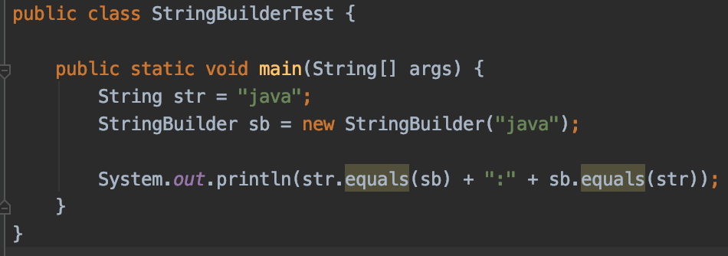
Q.1. Which will be the result of execution of the code ?
a) true:true
b) false:true
c) false:false
d) Compilation error
e) true:false
c) false:false equals() Method of String returns false if the type ref of the arg is not in the same memoery location, as it is here, and then it is different than String - that’s wy we do have false at first check sb.equals(). - StringBuilder does NOT override the equals method , so check by memoery allocation is being executed – which is false

Slide 3
Lunch break
Lunch break time
Starting at 14:30

Slide 4
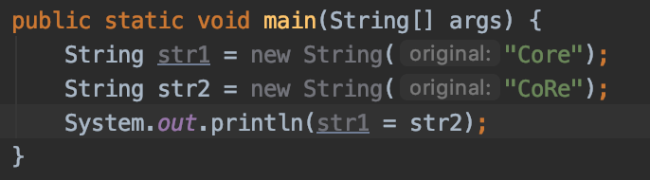
Q2. What is the result of execution of the code
a) CoRe
b) false
c) Core
d) true
CoRe - first it is inilized and them printed

Slide 5
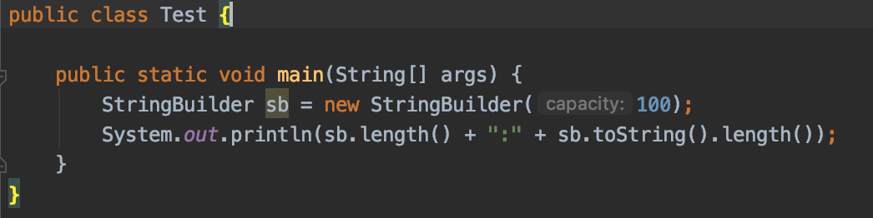
Q3. What is the result of executing of the code?
a) 100:100
b) 0:0
c) 100:0
d) 16:16
b) 0:0 -> this is capacity, not length

Slide 6
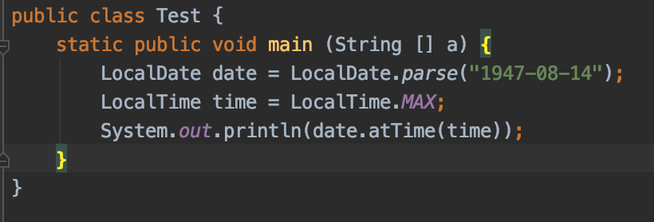
Q4. What is the result of compilation and execution of the code ?
a) 1947-08-14:T:23:59:59
b) 1947-08-14:T:23:59:59:999
c) 1947-08-14:T:23:59:59.0
d) 1947-08-14:T:23:59:59:999999999
d) 1947-08-14:T:23:59:59:999999999

Slide 7
Q5.
A bank's swift code is generally of 11 characters and used in international money transfers. An example of swift code: ICICINBBRT4 ICIC: First 4 letters for bank code IN: Next 2 letters for Country code BB: Next 2 letters for Location code RT4: Next 3 letters for Branch code
Which of the following code correctly extracts country code from the swift code referred by String reference variable swiftCode?
a) swiftCode.substring(4, 5);
b) swiftCode.substring(5, 6);
c) swiftCode.substring(5, 7);
d) swiftCode.substring(4, 6);
d) 4,6 - from 4 inclusive till 6 exclusive

Slide 8
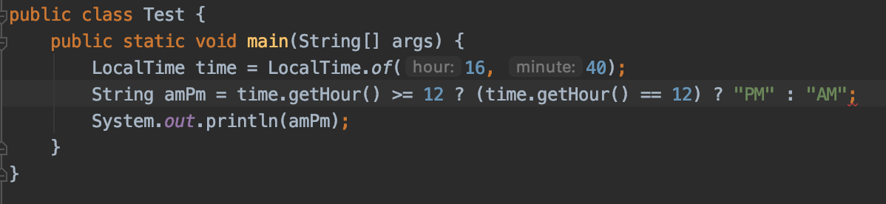
Q6. What will be the result of compiling and executing of the code?
Compilation error
AM
PM
An exception at runtime
a) compilation error - missing another :
- we do have 2 ?: operators here

Slide 9
Q7. Which of the statements is correct having the code ?
It will print any int value between 0 and 60
Code fails to compile
It will print any value in between 0 and 59
Compiles successfully but throws Runtime exception
import java.time.LocalDateTime;
public class Test {
public static void main(String [] args) {
LocalDateTime obj = LocalDateTime.now();
System.out.println(obj.getSecond());
}
}
c) Seconds are from 0 to 59

Slide 10
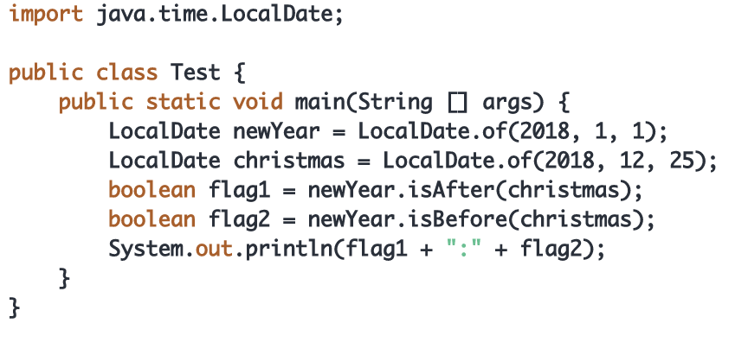
Q8. What will be the result fo compiling and executing the Test class?
false:true
An exception during runtime
true:false
Compilation error
a)

Slide 11
Q9: What will be the result of compiling and executing of the Test class
import java.time.LocalDate;
class MyLocalDate extends LocalDate {
@Override
public String toString() {
return super.getDayOfMonth() + "-" + super.getMonthValue() +
"-" + super.getYear();
}
}
public class Test {
public static void main(String [] args) {
MyLocalDate date = LocalDate.parse("1980-03-16");
System.out.println(date);
}
}
1980-03-16
16-3-1980
16-03-1980
Compilation error
An exception is throws at runtime
d)

Slide 12
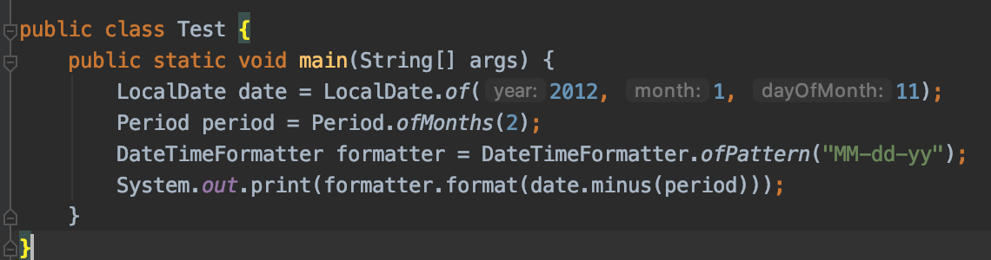
Q10 What will be the result of compiling and executing of test class?
01-11-11
Runtime exception
11-11-12
01-11-12
11-11-11
e)

Slide 13
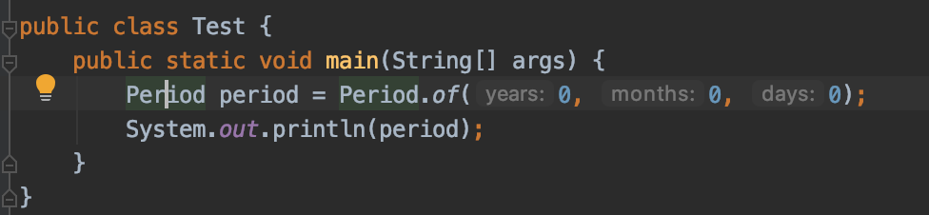
Q11 What will be the result of compiling and executing of Test class?
p0d
P0Y0M0D
p0y0m0d
P0D
d)

Slide 14
Q12. What will be the result of compiling and executing of Test class ?
2020-10-01
2020-09-30
An Exception is thrown during runtime
Compilation error
public class Test {
public static void main(String [] args) {
LocalDate date = LocalDate.of(2020, 9, 31);
System.out.println(date);
}
}
c) Sept has 30 days max

Slide 15
Q13. What will be the result of compiling and executing the Test class ?
public class Test {
public static void main(String[] args) {
StringBuilder sb = new StringBuilder("Java");
String s1 = sb.toString();
String s2 = sb.toString();
System.out.println(s1 == s2);
}
}
An exception is throws at runtime
Compilation error
false
true
c) false, toString{} of StringBuilder returns a new string

Slide 16
Q.14 What will be the result of compiling and executing of Test class ?
NullPointerException
Compilation error
4
1
public class Test {
public static void main(String[] args) {
StringBuilder sb = new StringBuilder();
System.out.println(sb.append(null).length());
}
}
b) append(null) – java can not define which overloaded method append to call

Slide 17
Q15 what will be the result of compiling and executing of Test class ?
true
Compilation error
OCAJP
false
public class Test {
public static void main(String[] args) {
String s1 = "OCAJP";
String s2 = "OCAJP" + "";
System.out.println(s1 == s2);
}
}
a) true

Slide 18
Q16 Which of the following are output of the code snip?
a) one
b) two
c) three
d) four
e) five
f) The code does not compile
String s = "Hello"; String t = new String(s);
if ("Hello".equals(s)) System.out.println("one");
if (t == s) System.out.println("two");
if (t.equals(s)) System.out.println("three");
if ("Hello" == s) System.out.println("four");
if ("Hello" == t) System.out.println("five");
A), c), D) one, three, four

Slide 19
Q17 Which are true statements ?
An immutable object can be modified
An immutable object can not be modified
An immutable object can be garbage collected
An imputable object can not be garbage collected
String is immutable
StringBuffer is immutable
StringBuilder is immutable
b), c), e)

Slide 20
Q.18 Which are the results of the following code? (Choose al apply)
A) 5
b) 6
c) c
d) d
e) An exception is thrown
f) Compilation error
String letters = "abcdef"; System.out.println(letters.length()); System.out.println(letters.charAt(3)); System.out.println(letters.charAt(6));
b) d), e)

Slide 21
Q19. What is the result of the following code?
a) 1
b) 2
c) 3
e) 7
f) An exception is thrown
e) A compilation error
int total = 0; StringBuilder letters = new StringBuilder("abcdefg"); total += letters.substring(1, 2).length(); total += letters.substring(6, 6).length(); total += letters.substring(6, 5).length(); System.out.println(total);
f) compilation error as 6.5 range

Slide 22
Q20. Which of the following can be inserted into the blank to create a date of June 21, 2014?
a) new LocalDate(2014, 5, 21);
b) new LocalDate(2014, 6, 21);
c) LocalDate.of(2014, 5, 21);
d) LocalDate.of(2014, 6, 21); e) LocalDate.of(2014, Calendar.JUNE, 21);
f) LocalDate.of(2014, Month.JUNE, 21);
LocalDate date = ____________________________
d) and f)

Slide 23
Thank You For Your Time

